Slide 1

Books Manager Application Java FX

Slide 2
Components of Application
Add Book | Update Book | Delete Book | Search Book
Add Title , Author | Update Title , Author | Delete Title , Author | Search Title
Add Year | Update Year | Delete Year
Add Pages | Update Pages | Delete Pages

Slide 3
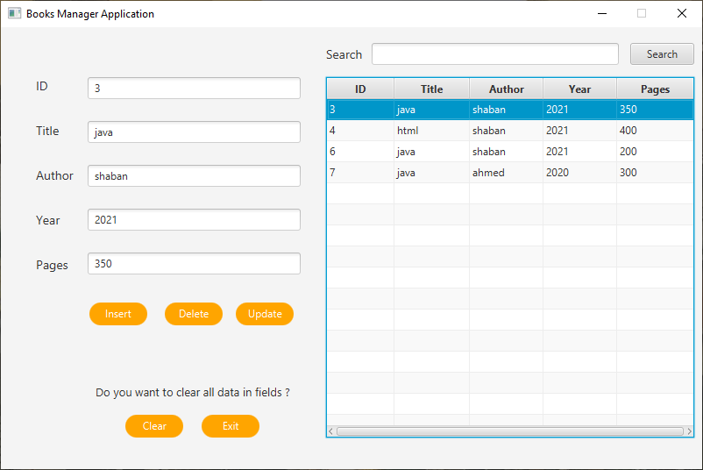
Desktop Application

Slide 4
1- Add Book

Slide 5
1- Add Book
1- must Add title of book
2- must Add author of book
3- must Add publishing year of book
4- must Add number of pages
5- once you clicked on insert button , data on text fields cleared to add new product again .

Slide 6
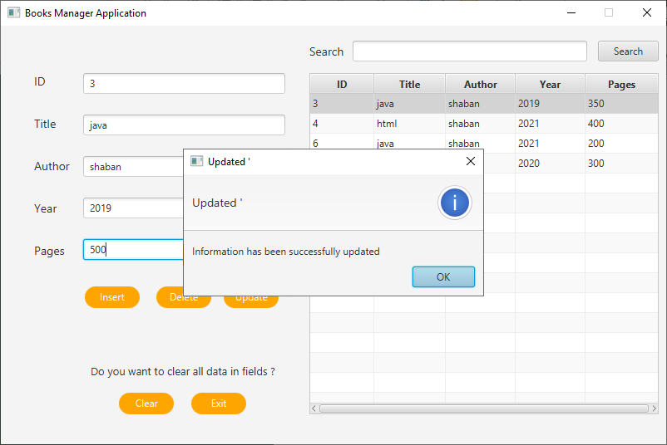
2- Update Book

Slide 7
2- Update Book
1- can update title of book
2- can update author of book
3- can update publishing year of book
4- can update number of pages
5- once you clicked on update button , data updated in database and new data show in table

Slide 8
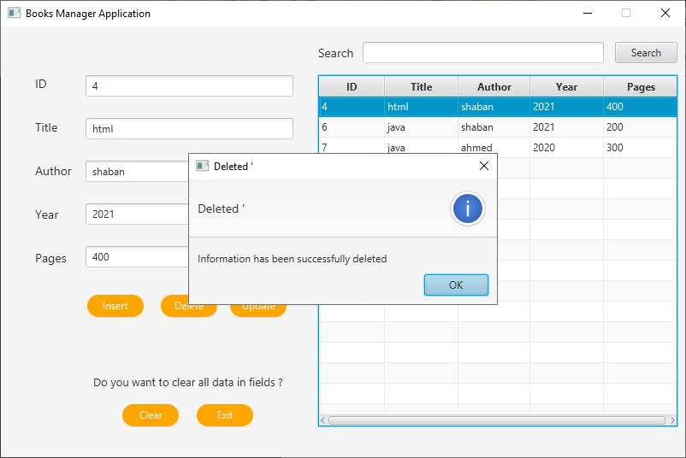
3- Delete Book

Slide 9
3- Delete Book
1- delete title of book
2- delete author of book
3- delete publishing year of book
4- delete number of pages
5- once you clicked on delete button , data deleted from database and next product is selected

Slide 10
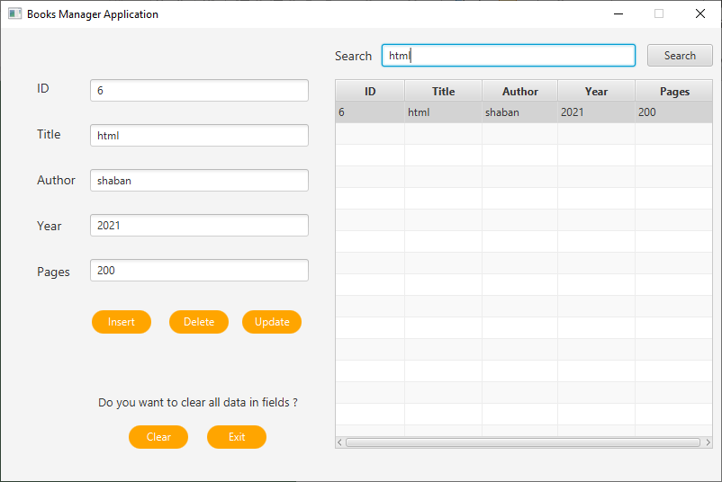
4- Search Book

Slide 11
4- Search Book
1- type title of book in search text field , Once you type first characters of book title and clicked on search button ; there is filter function that filter content of table and show only book title that match with keywords entered in search filed.

Slide 12

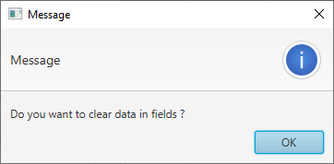
5- Clear , Exit

Slide 13
5- Clear , Exit
1- click on clear button , if you want to enter new data and delete all current text field data
2- exit button to exit from application

